Slide 1
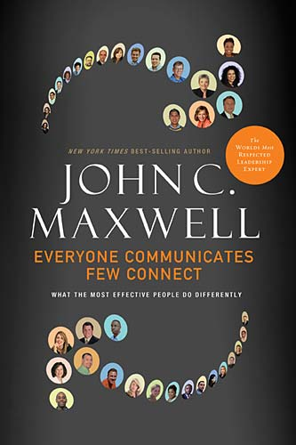
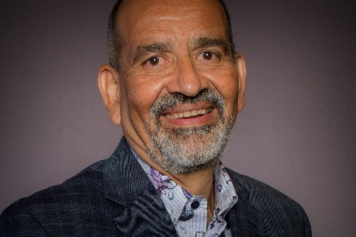
Welcome Bienvenidos
Memo Vargas

Slide 2
Connecting Principles #1 INFLUENCE
Principle #1 - Connecting increases your influence in every situation.
Successful US Presidents exhibit 5 qualities:
Vision
Pragmatism
Consensus Building
Charisma
Trustworthiness
4 of the 5 skills to being a successful leader have to do with connecting.
Notes:
Connecting is the ability to identify with people and relate to them in such a way that it increases our influence with them.

Slide 3
Connecting Principles #1 INFLUENCE
Most people who disconnect aren’t aware.
Connecting Signals
Extra Effort:
people go the extra mile
Unsolicited Appreciation:
people say positive things
Unguarded Openness:
people demonstrate trust
Increased Communication:
people express themselves more readily
Enjoyable Experiences:
people feel good about what they are doing
Emotional Bondedness:
people display a connection on an emotional level
Positive Energy:
people’s emotional “batteries” are charged by being together
Growing Synergy:
people’s effectiveness is greater than the sum of the contributions
Unconditional Love:
people are accepting without reservation

Slide 4
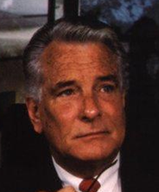
Connecting Principles #1 INFLUENCE
Jay Hall, PhD, Teleometrics, conducted a study on the performance of 16,000 executives.
CONCLUSION: direct correlation between achievement and the ability to care for and connect with people.
Notes:
The ability to connect with others begins with understanding the value of people

Slide 5
Connecting Principles #1 INFLUENCE
HIGH ACHIEVERS
AVERAGE ACHIEVERS
LOW ACHIEVERS
Care about People as well as Profits
Concentrate on Production
Preoccupied with their own Security
View subordinates Optimistically
Focus more on their own Status
Show a basic Distrust of subordinates
Seek advice from those under them
Reluctant to seek advice from those under them
Do not seek advice
Actively listen
Listen only to superiors
Avoid communication and rely on policy manuals

Slide 6
Connecting Principles #2 OTHERS
Principle #2 - Connecting is all about OTHERS and not ourselves.
Why do we focus on ourselves and not others?
Immaturity
Maturity is the ability to see and act on behalf of others
Ego
Failure to value everyone
3 Connecting Questions:
Do you CARE for me?
Can you HELP me?
Can I TRUST you?

Slide 7
Connecting Principles #3 COMMUNICATION
Principle #3 – Connecting goes beyond words
3 Components to Face-to-Face communication
How others believe what we say when we communicate:
>90% of the impression that we often convey
has nothing to do with what we actually say!
WORDS
TONE OF VOICE
BODY LANGUAGE

Slide 8
Connecting Principles #3 COMMUNICATION
3 Components to Communication
Thought
Emotion
Action
Notes:
When thought, emotion and action are congruent, connecting goes beyond what we say because we are now emoting what people can feel and we are connecting with them more than just verbally.

Slide 9
Connecting Principles #3 COMMUNICATION
Communication Breakdowns
Breakdown | Thought – knowing | Emotion – feeling | Action - doing
Dispassionate | I know this | I do not feel this
Theoretical | I know this |  | I do not do this
Unfounded | I do not know this | I feel this
Hypocritical |  | I feel this | I do not do this
Presumptuous | I do not know this |  | I do this
Mechanical |  | I do not feel this | I do this

Slide 10
Connecting Principles #3 COMMUNICATION
Action – something we do; connecting visually; what people see
Thought – something we know; connecting intellectually; what people understand
Emotion – something we feel; connecting emotionally; what people feel
Notes:
Action:
To connect with people visually
Expand your range of expression
Move with a sense of purpose
Maintain an open posture
Thought:
To connect with people intellectually
Knowledge must be experiential
Experience is not only a good teacher, it is a great persuader
Emotion:
To connect with people emotionally
People may hear your words but they feel your attitude

Slide 11
Connecting Principles #4 ENERGY
Principle #4 – Connecting always requires ENERGY
4 Unpardonable sins of a communicator:
3 of the 4 require a lot of effort and energy
Connecting requires:
Initiative – go first!
Clarity – prepare
Patience – slow down
Selflessness – give
Stamina – recharge
Unprepared
Uncommitted
Uninteresting
Uncomfortable

Slide 12
Connecting Principles #5 SKILL
Principle #5 – Connecting is more SKILL than natural talent
Successful Connecting
Relationships Who you know
Insight
What you know
Success
What you have done
Ability
What you
can do
Sacrifice
How you live

Slide 13
Connecting Practices #1 COMMON GROUND
Practice #1 – Connectors connect on common ground
Barriers to finding common ground:
Assumption
Arrogance
Control
Indifference
Notes:
Assumption – “I already know what others know, feel and want.”
Arrogance – “I don’t need to know what others know, feel or want.”
Indifference – “I don’t care to know what others know, feel, or want.”
Control – “I don’t want others to know what I know, feel or think.”

Slide 14
Connecting Practices #1 COMMON GROUND
Choices to finding common ground:
Availability
Listening
Questions
Thoughtfulness
Openness
Likeability
Humility
Adaptability
Notes:
Availability – I will choose to spend time with others
Listening – I will listen my way to common ground
Questions – I will be interested enough in others to ask questions
Thoughtfulness – I will think of others and look for ways to help them
Openness – I will let people into my life
Likeability – I will care about people
Humility – I will think of myself less so I can think of others more
Adaptability – I will move from my world to theirs

Slide 15
Connecting Practices #2 Simplicity
Practice #2 – Connectors do the difficult work of keeping it SIMPLE
4 components to connect through communication
Humor
Heart
Hope
Help
Three S’s
Have a Smile
Say it Slowly
Keep it Simple
Art of Simplicity
Talk to people, not above them
Get to the point
Say it over and over and over again
Say it clearly
Say less

Slide 16
Connecting Practices #3 EXPERIENCE
Practice #3 – Create an EXPERIENCE everyone enjoys
How to be interesting:
Take responsibility for your listeners
Communicate in their world
Capture people’s attention from the start
Say it so it sticks

Slide 17
Connecting Practices #4 INSPIRE
What people KNOW
What people FEEL
Inspiration
What people SEE
Practice #4 – Connectors INSPIRE people
Inspiration Equation
What do people need to KNOW?
That you understand them and are focused on them
That you have high expectations of them
What do people need to SEE?
Your conviction
Your example
What do people need to FEEL?
Your confidence in yourself and them
Your gratitude for them

Slide 18
Connecting Practices #5 CREDIBILITY
Practice #5 – CREDIBILITY is the currency that connectors have
Credibility Checklist
Have I connected with myself?
Have I made right my wrongs?
Am I accountable?
Do I lead like I live?
Do I tell the truth?
Am I vulnerable?
Am I following the Golden Rule?
Do I deliver results?

Slide 19
Thank you Gracias
Memo Vargas

